Slide 1
REACT JS Notes
By Dhruv DHOLARIYA

Slide 2
UseState
UseEffect
UseNavigate
UseParams
UseSearchParams
Context API and useContext
UseRef

Slide 3
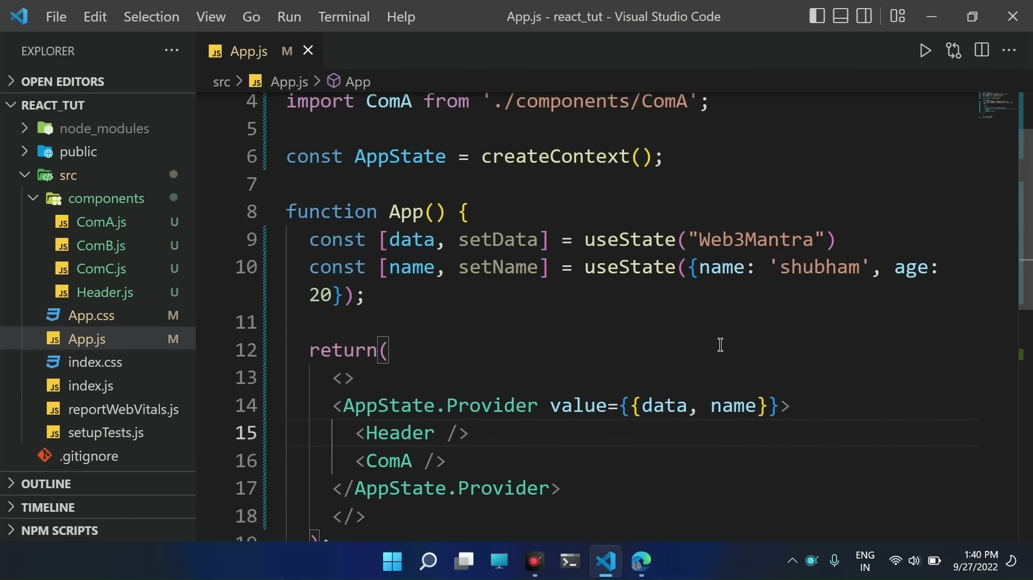
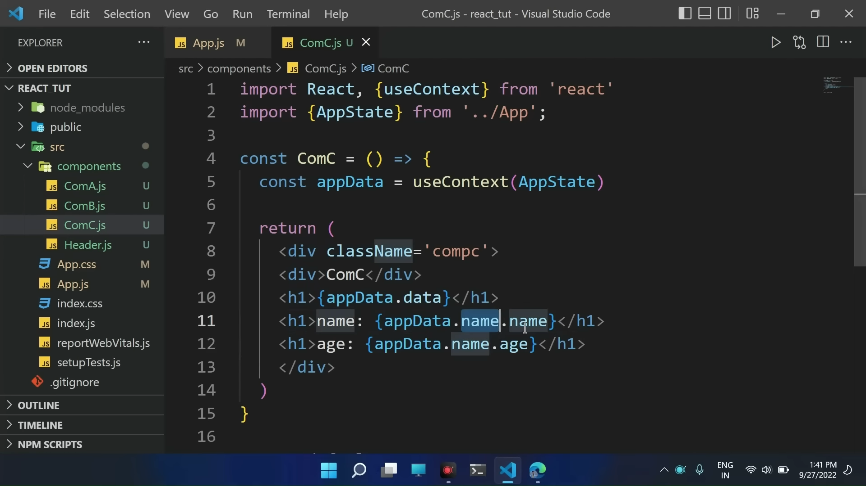
Context Api and Usecontext

Slide 4
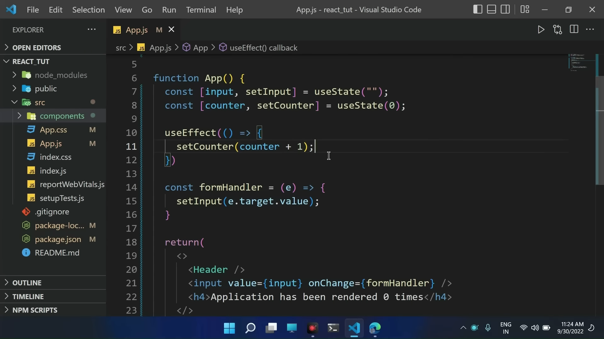
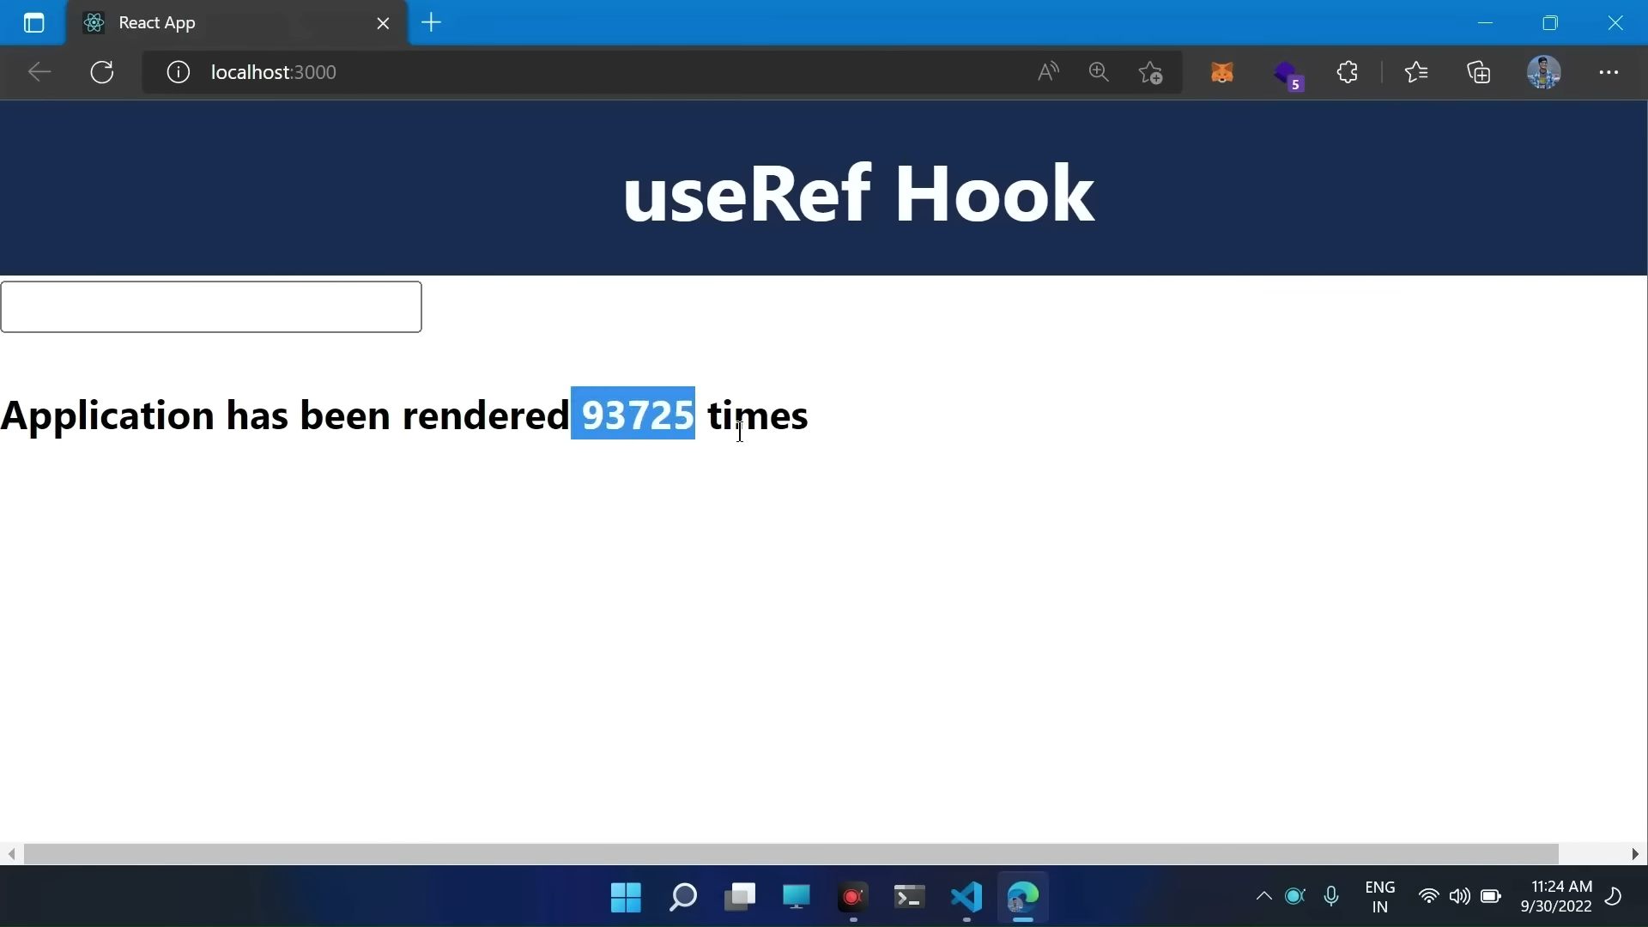
USEREF
Goes in infinite loop

Slide 5
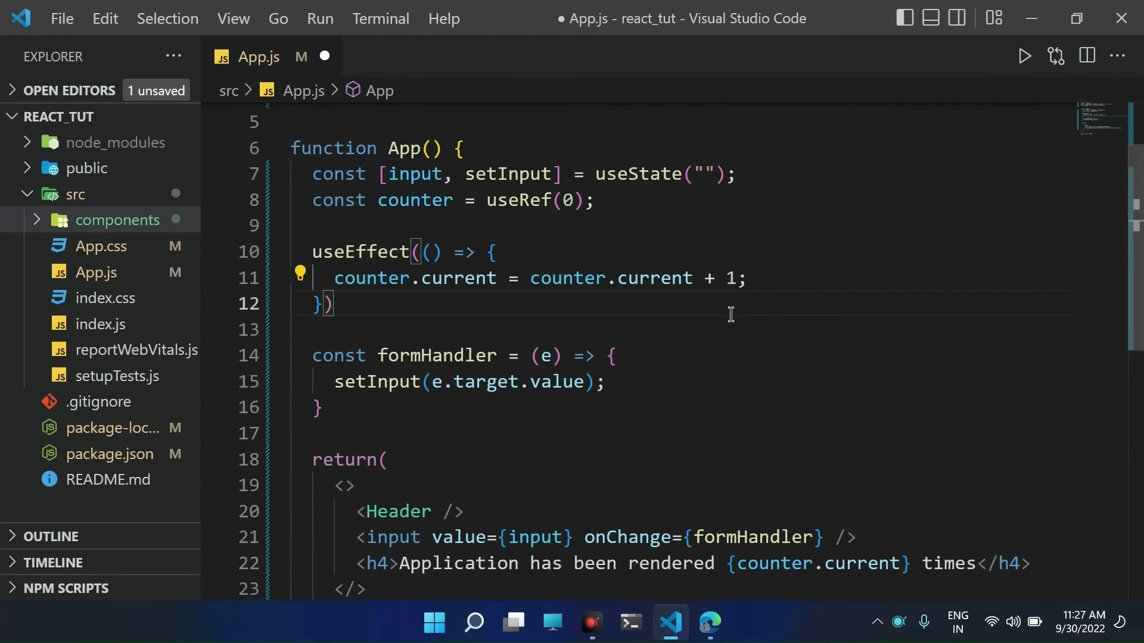
Solution to the problem

Slide 6
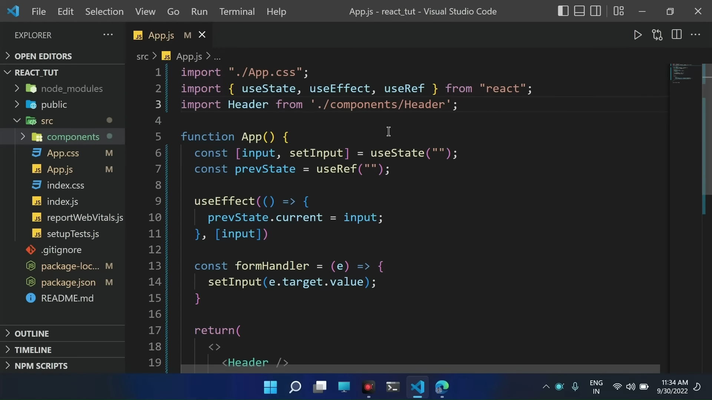
Can also be used to store previous value of state

Slide 7
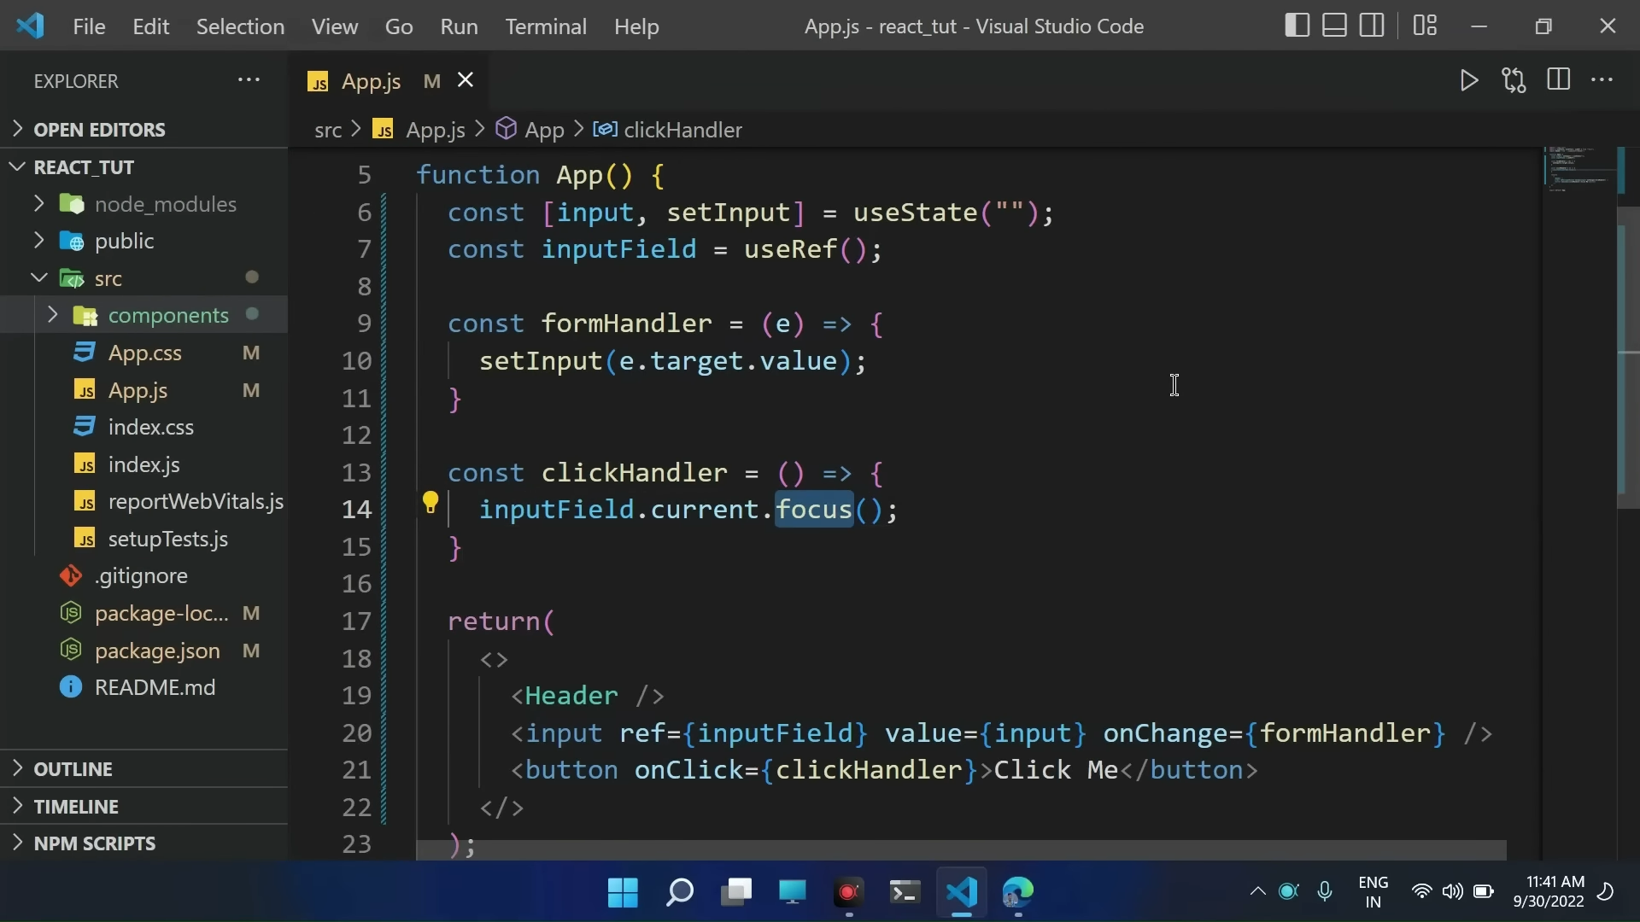
To Focus input field

Slide 8
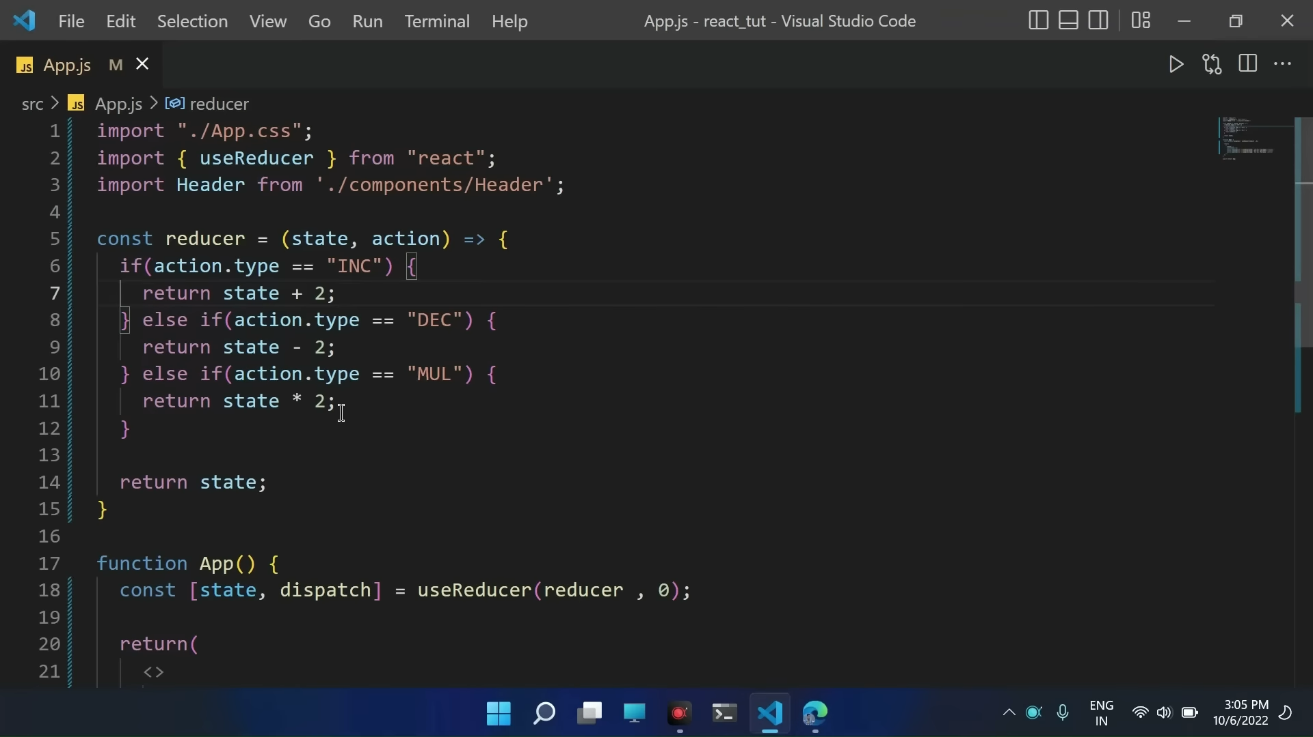
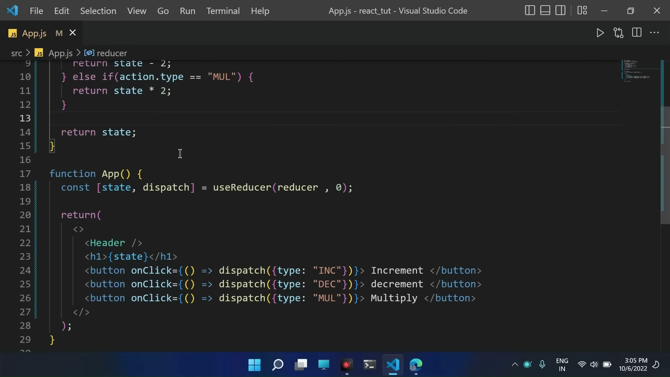
USEREDUCUER

Slide 9
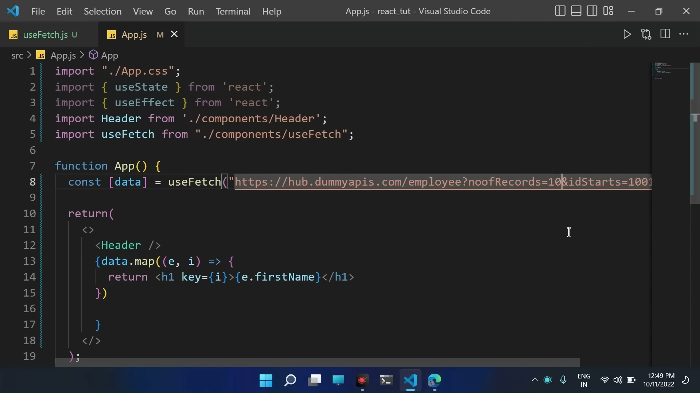
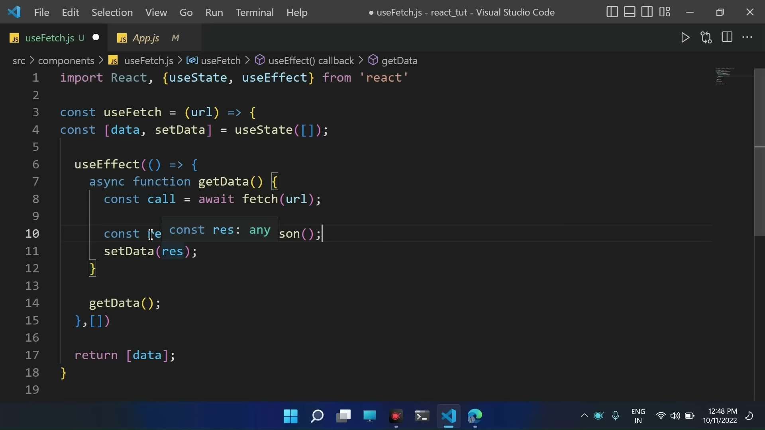
CUSTOM HOOKS
useFetch is our custom hook

Slide 10
Usememo and usecallback
https://www.youtube.com/watch?v=lLeZ8Cr2YVM&t=32841s

Slide 11
Class based components

Slide 12
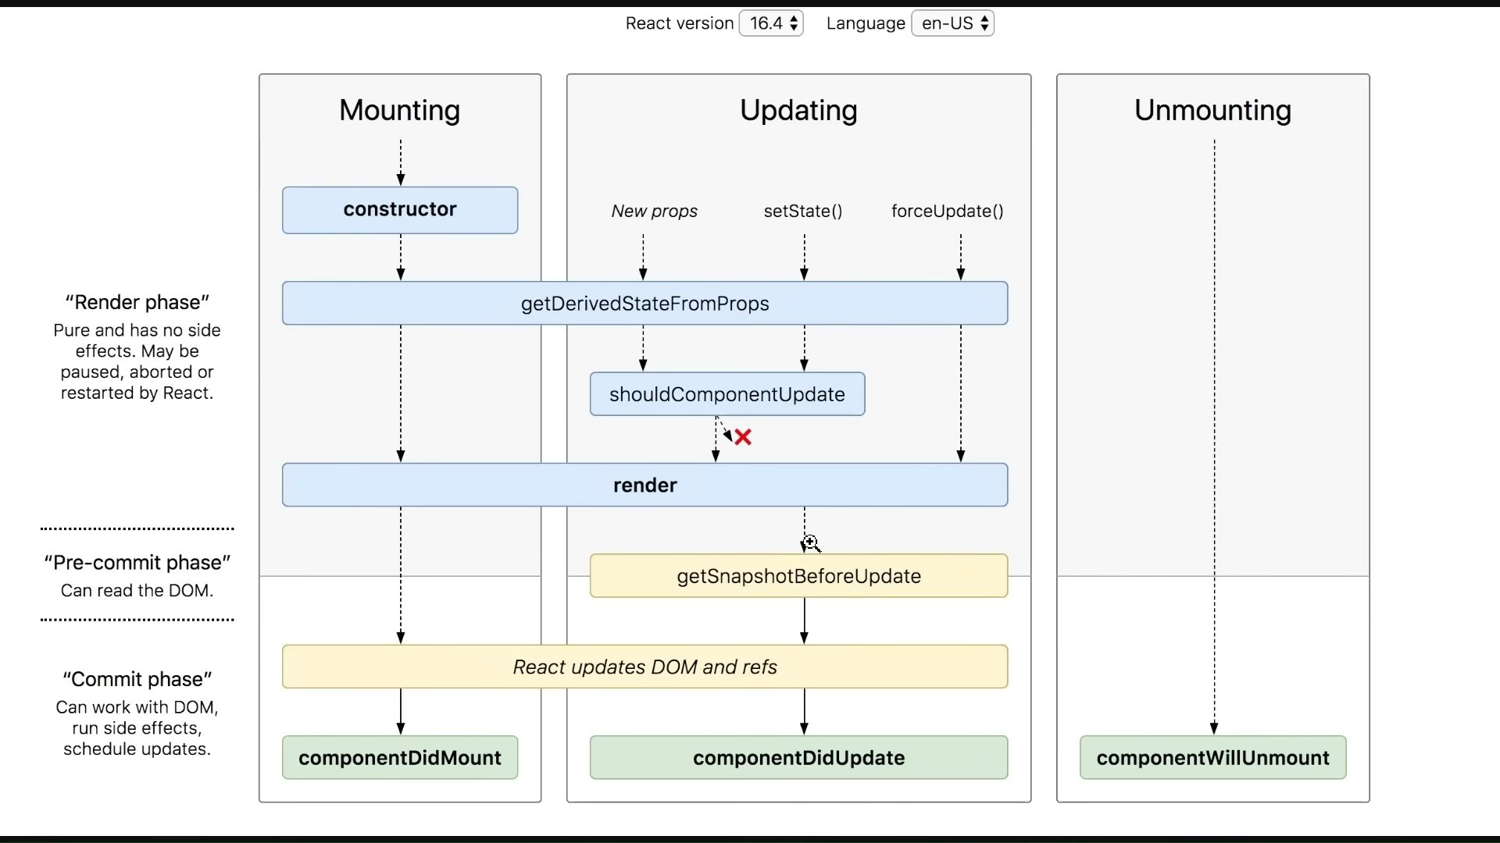

Slide 16
AG Grid

Slide 17
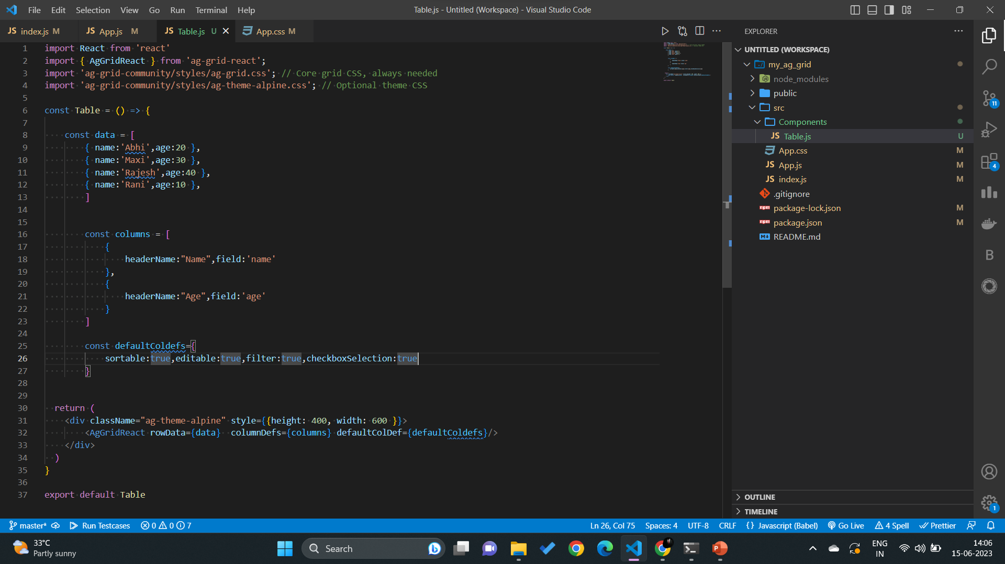
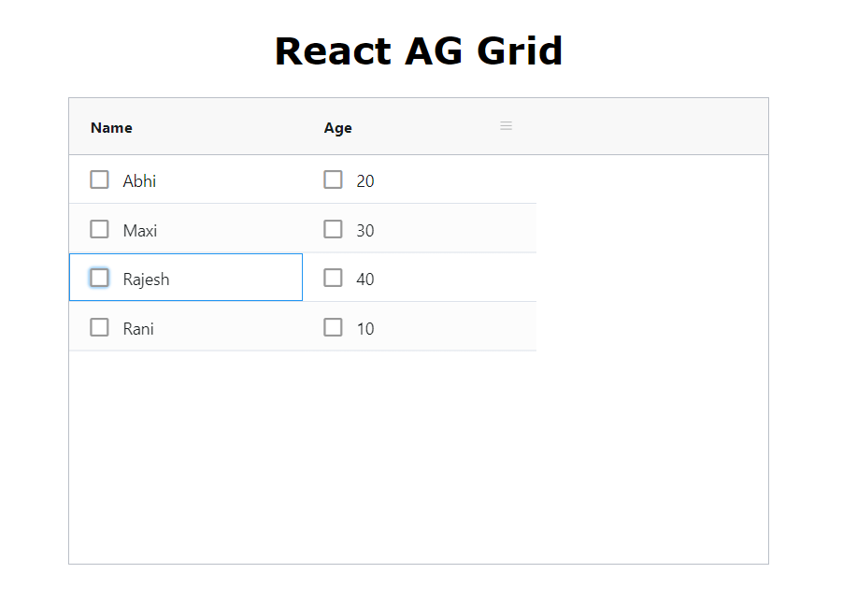

Slide 18
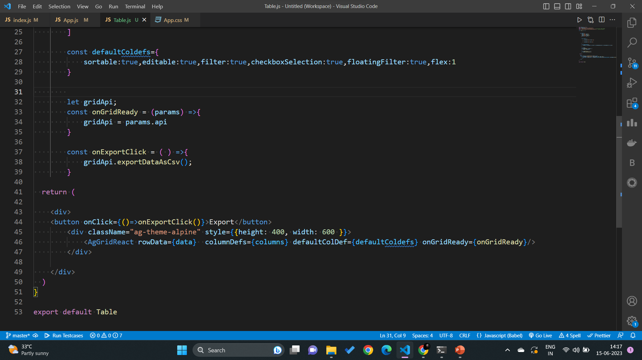

Slide 19
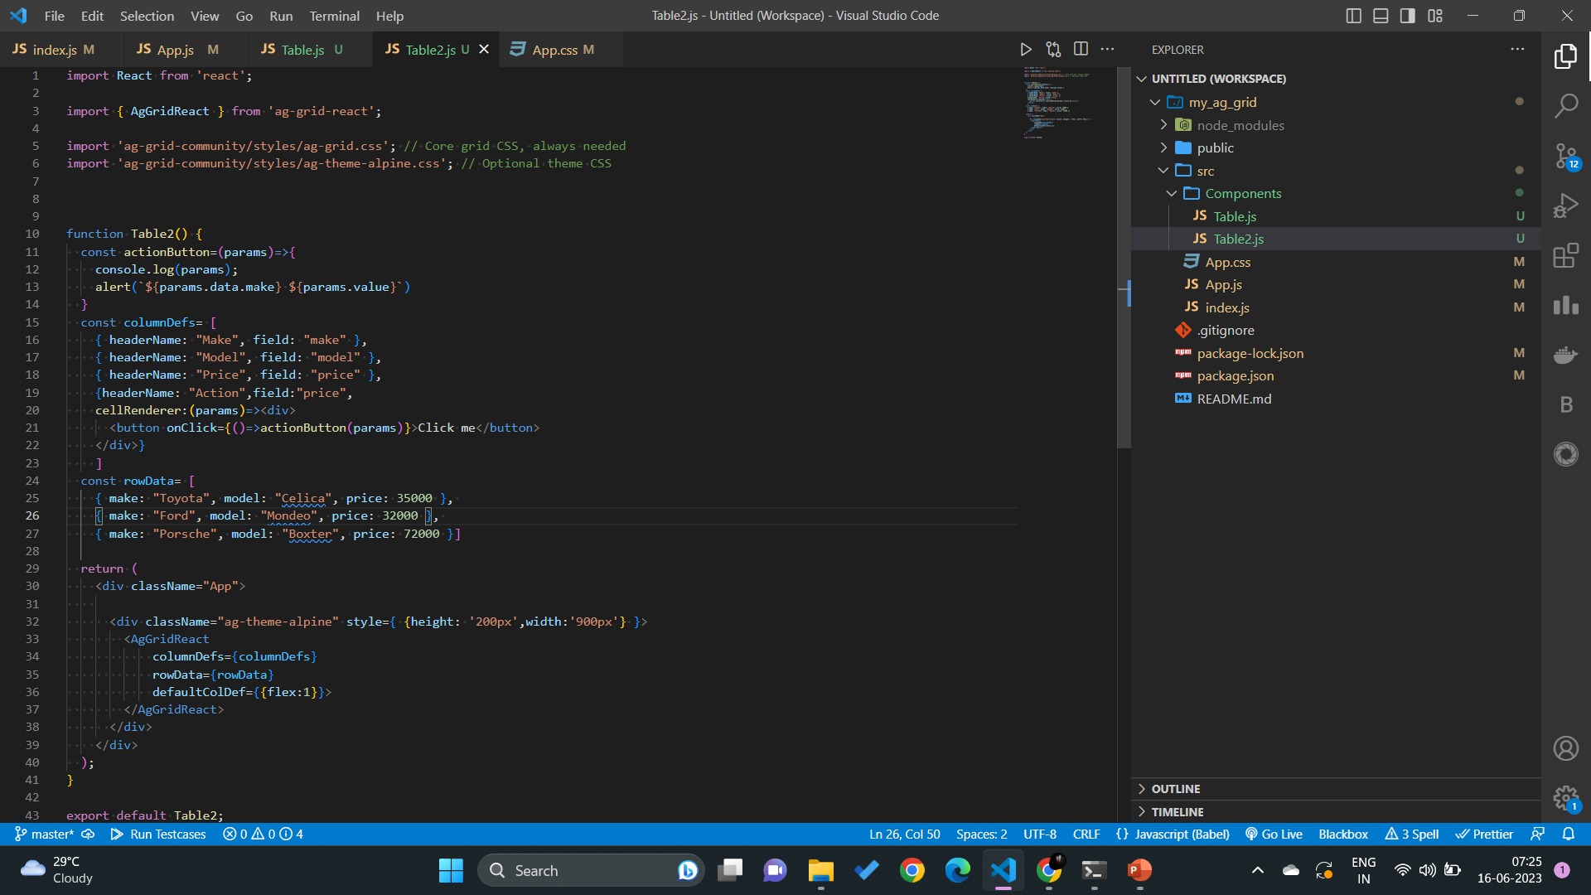
Render components- cellrenderer

Slide 20
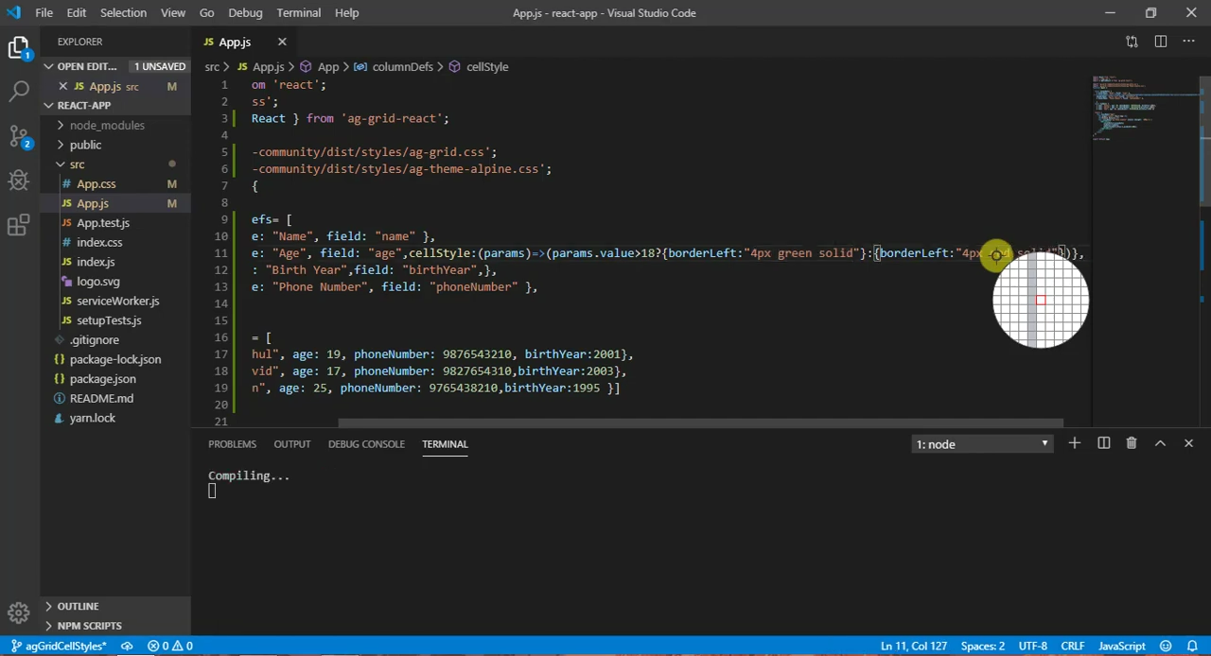
Conditional styling - cellstyle

Slide 21
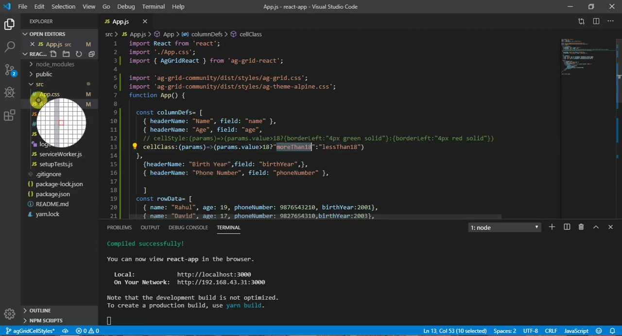
Conditional styling - cellclass

Slide 22
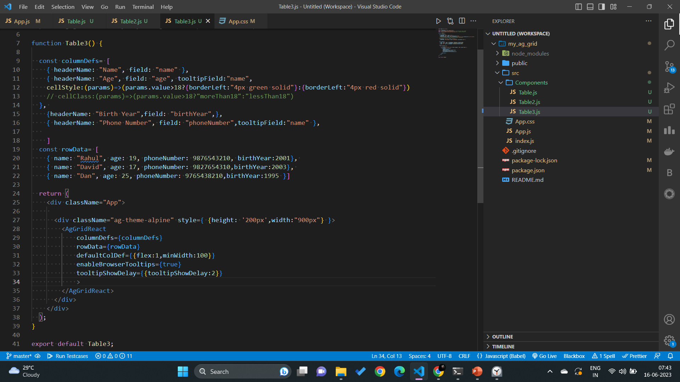

Tooltip

Slide 23
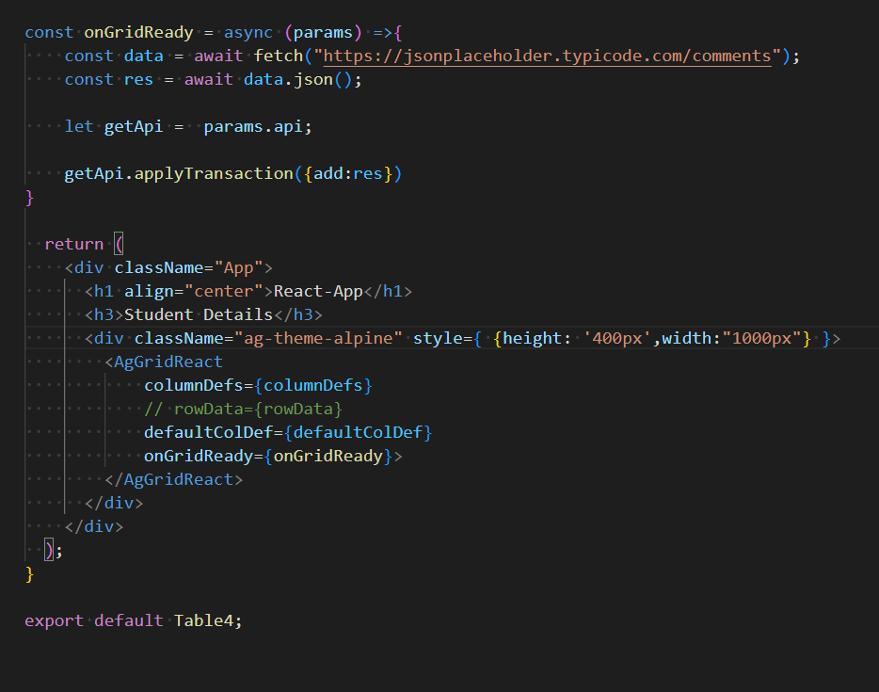
Using API to fetch data

Slide 24
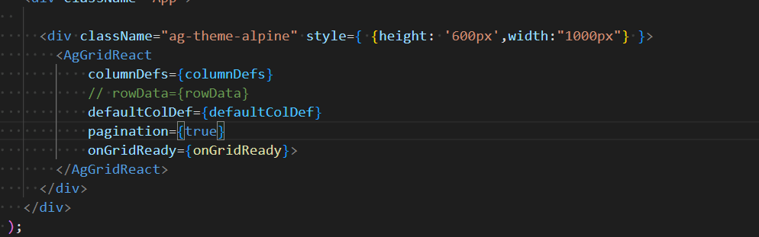

Pagination

Slide 25
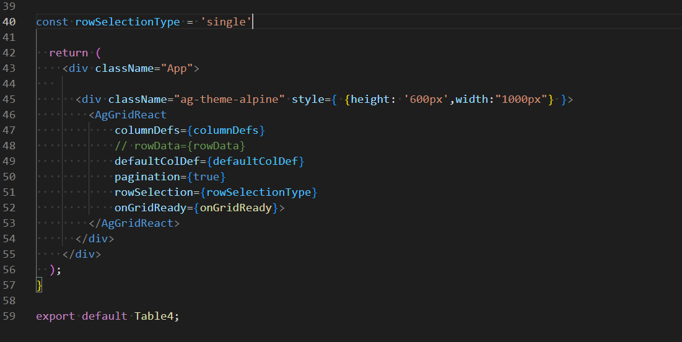
ROW SELECTION

Slide 26
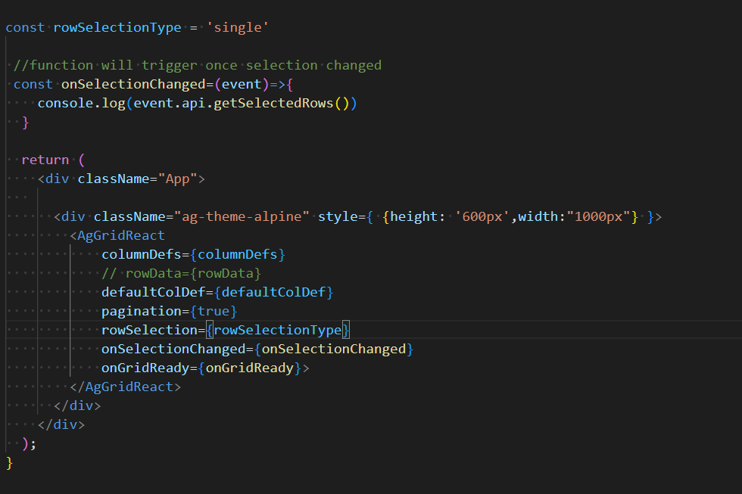
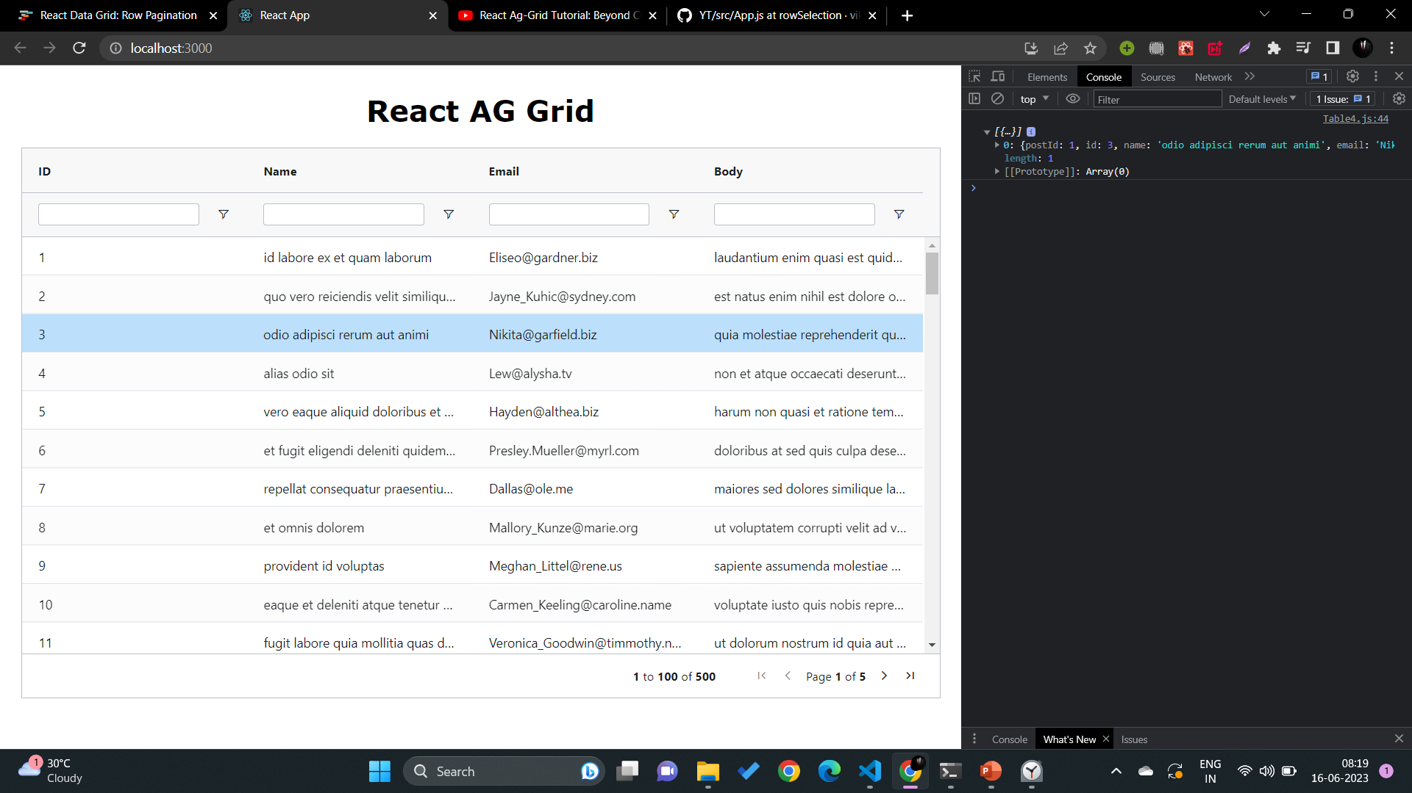


PRINT DATA OF ROW SELECTED

Slide 27
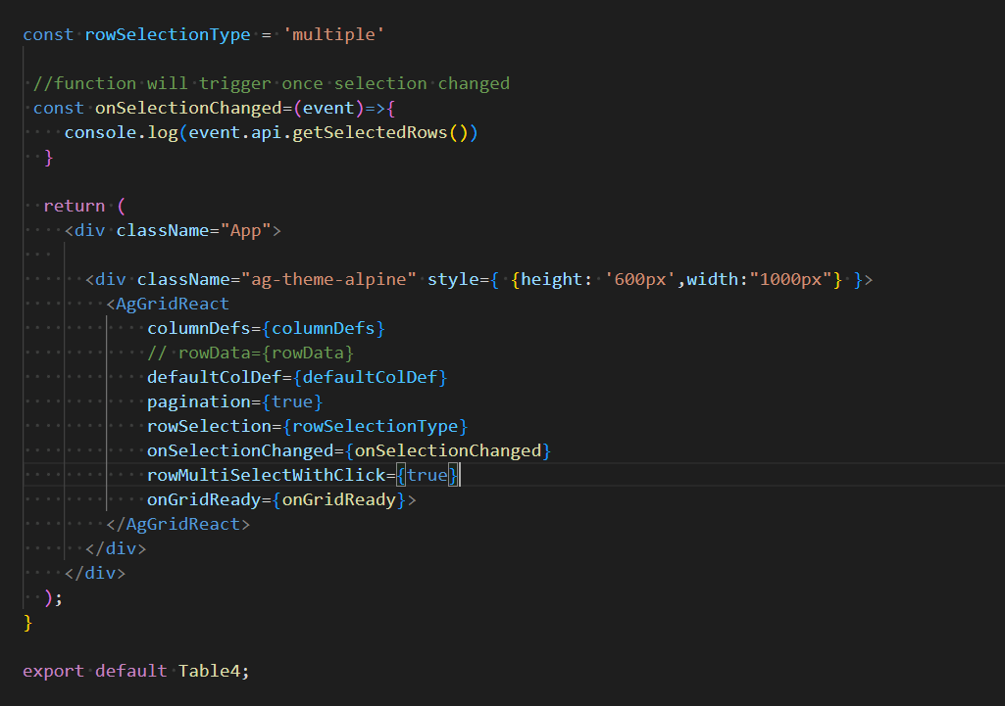
Select multiple row without ctrl

Slide 28
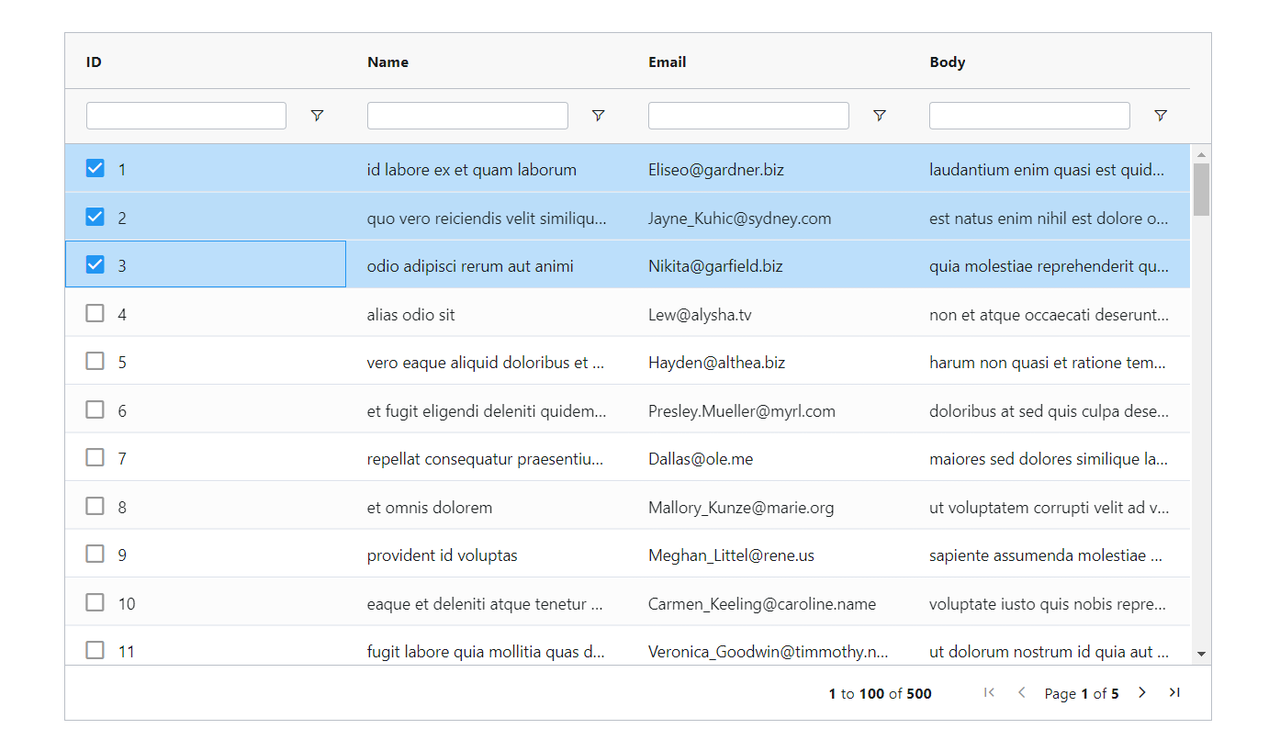
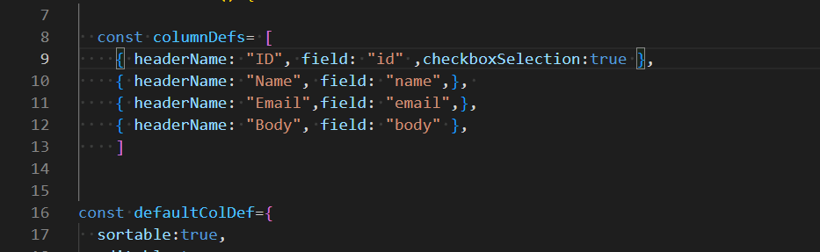
Checkbox selection

Slide 29
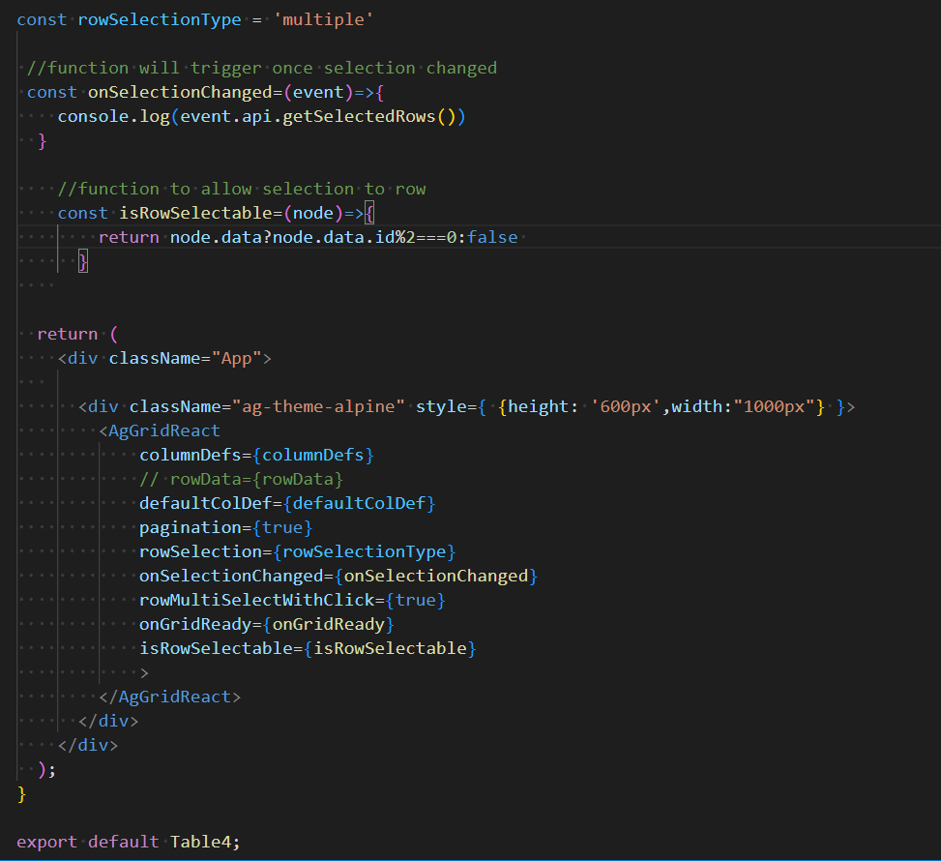

ROW SELECTION with condition that only id even can be selected

Slide 30
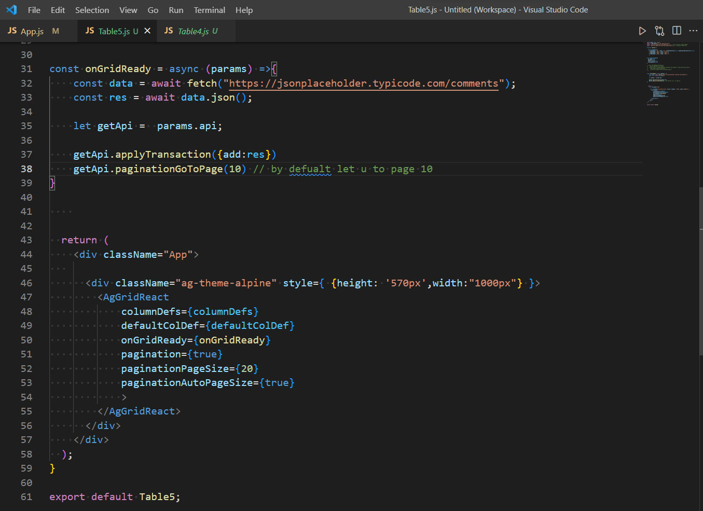

Pagination

Slide 31
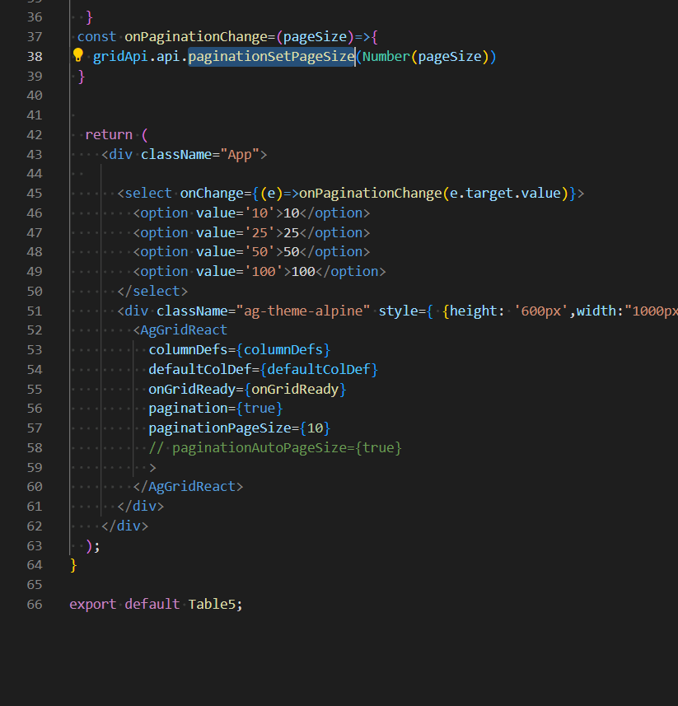


Dynamic dropdown pagination

Slide 32
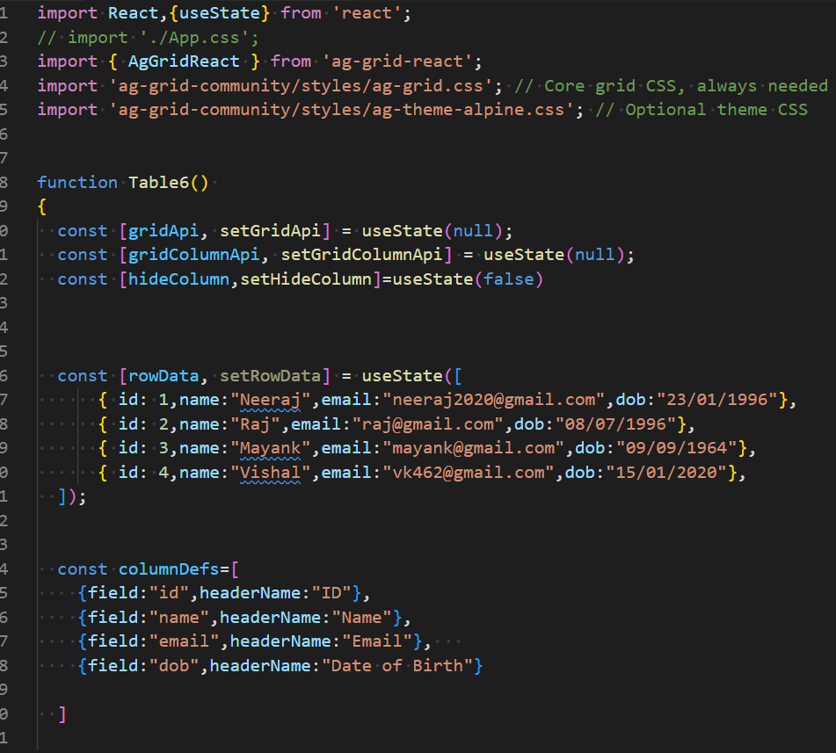
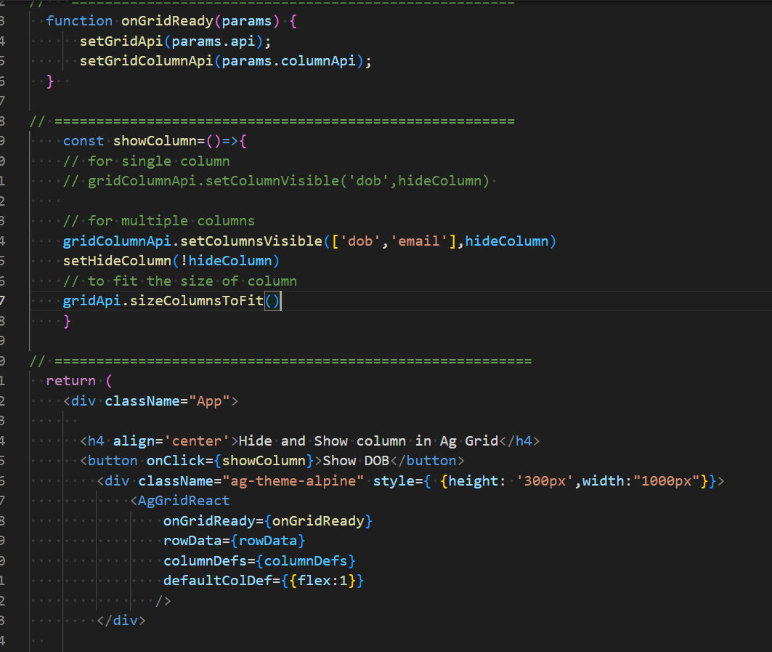


Hide / Show column in ag grid

Slide 33
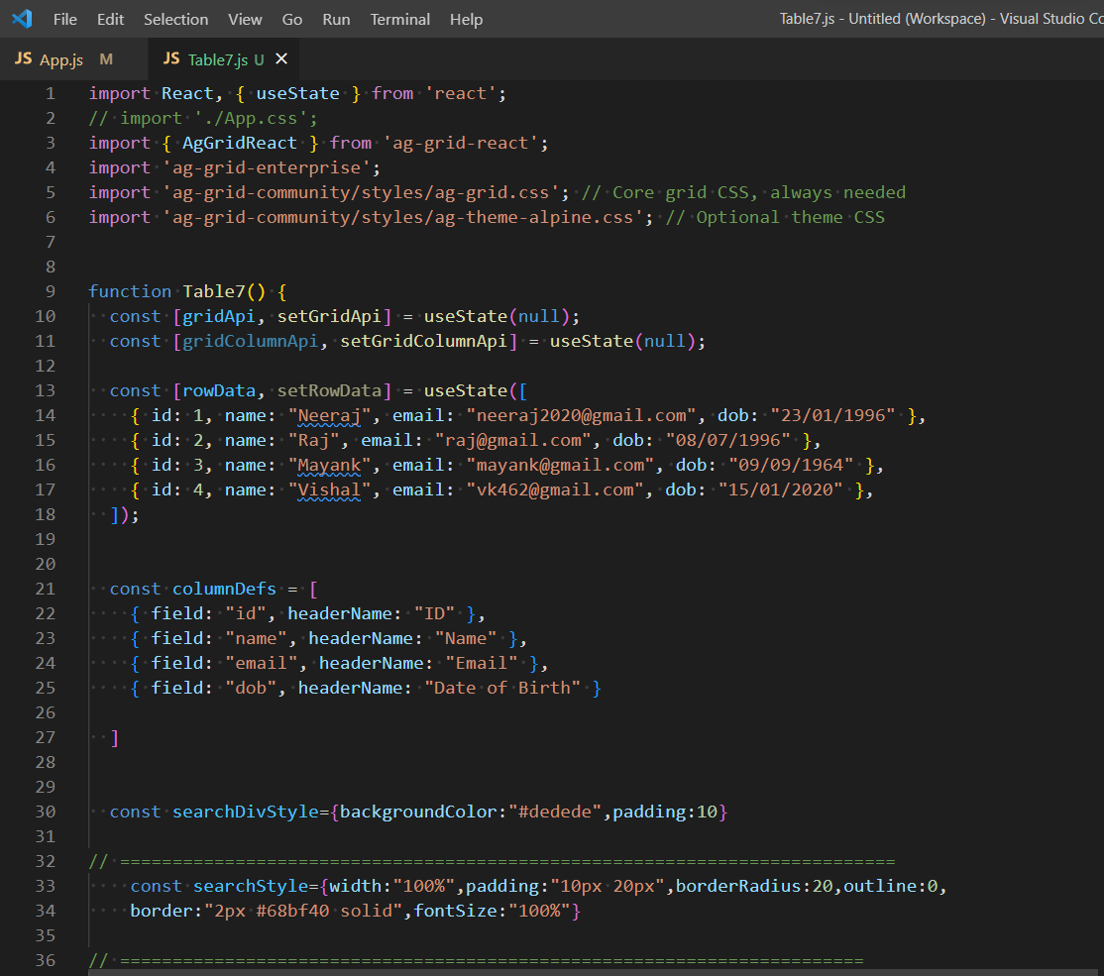
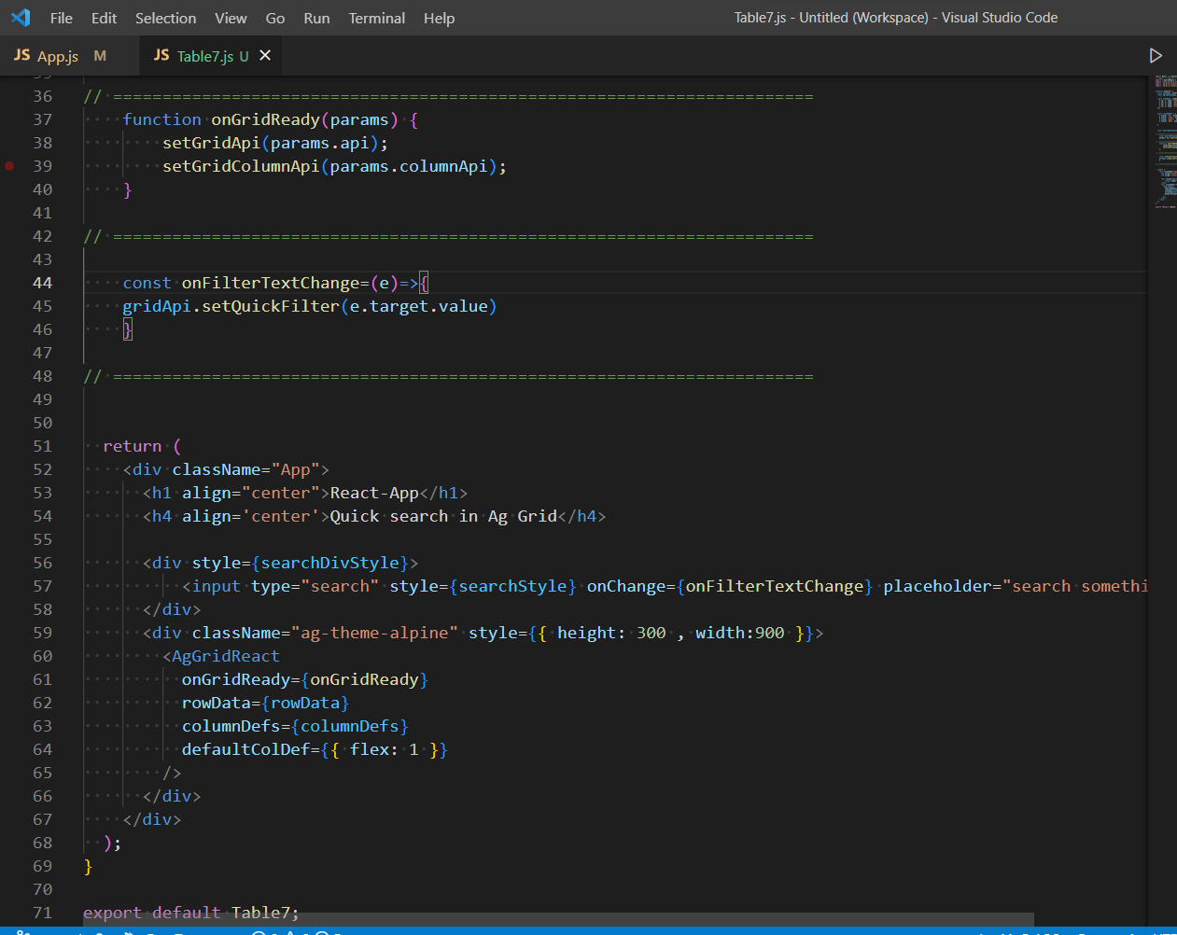
QUICK SEARCH

Slide 34
Server side pagination , filtering , search , sorting

